Slide 1


Food Delivery Performance Analytics Dashboard
The Food Delivery Performance Analytics Dashboard is a comprehensive Power BI solution designed to analyze end-to-end food delivery operations.

Slide 2



Project Overview
Tracks KPIs: customers, orders, revenue, delivery efficiency, order status.
Power BI dashboard for end-to-end food delivery analysis.
Converts raw operational data into actionable business insights.

Slide 3

Project Context
01
Food delivery is competitive; efficiency and satisfaction are key.
🏢
02
Data often fragmented across partners, payments, and periods.
03
Dashboard consolidates all metrics for better monitoring and optimization.

Slide 4
Project Objectives
Analyze order status (Delivered, Cancelled, Pending, Returned).
Track customers, orders, revenue, and menus.
Monitor delivery time performance.
01
03
02
Study ordering behavior by meal period and day.
Compare performance across delivery partners and payment modes.
Improve operations and customer satisfaction.

Slide 5
Target Audience
Operations Managers – Delivery efficiency insights.
Marketing Teams – Campaign planning based on demand.
Leadership – High-level performance overview.
Business Analysts – Trend analysis & growth opportunities.
Product Managers – Menu and pricing optimization.

Slide 6
Business Problems Addressed
No unified KPI view.
No revenue trend analysis.
Limited visibility of cancellations & delays.
Difficulty tracking delivery partner performance.
Lack of peak ordering time insights.

Slide 7



Key Features & Visual Insights
KPI Cards: Customers, Orders, Revenue, Menus, Avg Delivery Time.
Order Summary: Delivered, Cancelled, Pending, Returned (Doughnut chart).
Orders by Meal Period: Morning, Afternoon, Evening, Night.
Delivery Partner Performance: Uber Eats, Swiggy, Zomato, Dunzo, In-house.

Slide 8
Key Features & Visual Insights
Revenue by Month: Line/Area chart for growth and trends.
01
Orders by Delivery Time: 11–50+ mins delivery distribution.
02
Orders by Day Name: Identify peak weekdays.
03
Filters & Slicers: Month, Payment Mode.
04

Slide 9
Data Sources & Description
Orders, Customers, Partners, Payment, Date datasets
CSV / Excel files
Data cleaning via Power Query.

Slide 10




Project Lifecycle & Technical Workflow
Requirement Gathering → Data Collection → Cleaning → Modeling → DAX → UI & Visuals → Insight Generation

Slide 11
Data Modeling Approach
Fact Table: Orders
Relationships: One-to-many
1
2
3
4
Schema: Star Schema
Dimensions: Customers, Delivery Partners, Date, Payment

Slide 12
DAX Measures Implemented
Total Customers = DISTINCTCOUNT(Customer_ID)
Total Orders = COUNT(Order_ID)
Delivered Orders % = DIVIDE([Delivered Orders], [Total Orders])
Total Revenue = SUM(Revenue)
Average Delivery Time = AVERAGE(Delivery_Time)

Slide 13
Insight Generation & Analysis
01
02
Peak ordering times identified for staffing optimization.
Evaluated partner performance.
A
B
03
C
D
04
Delivery time correlated with cancellation rates.
High-demand menu items identified by meal period.

Slide 14




Performance Dashboard Metrics
Orders: 12,450 → Peak on weekends
Delivered Orders %: 92% → High operational efficiency
Revenue: $245,000 → 15% monthly growth
Customers: 5,620 → Repeat orders indicate loyalty
Average Delivery Time: 28 mins → 85% on-time delivery

Slide 15
Key Business Takeaways
Longer delivery → cancellations
Online payments > COD
Morning & afternoon peak
Weekday trends → staffing
Orders mostly delivered

Slide 16



Tools & Technologies Used
Power BI Desktop, Power Query, DAX, CSV / Excel
Star Schema Data Modeling

Slide 17
Best Practices & Recommendations
Maintain centralized real-time data.
Optimize delivery routes during peak hours.
Track high-demand items for inventory planning.
Monitor partner performance monthly.

Slide 18




Future Scope
Geo-map delivery locations
Rider performance & SLA tracking
Predict delivery time using ML
Customer segmentation & loyalty analysis

Slide 19


How to Use This Project
Clone/download repository
Open .pbix in Power BIs
Load sample/actual dataset
Interact with filters and visuals

Slide 20
Conclusion
Improve delivery efficiency
Reduce delays & cancellations
Optimize partner performance
Enhance satisfaction &
Support data-driven decisions

Slide 21
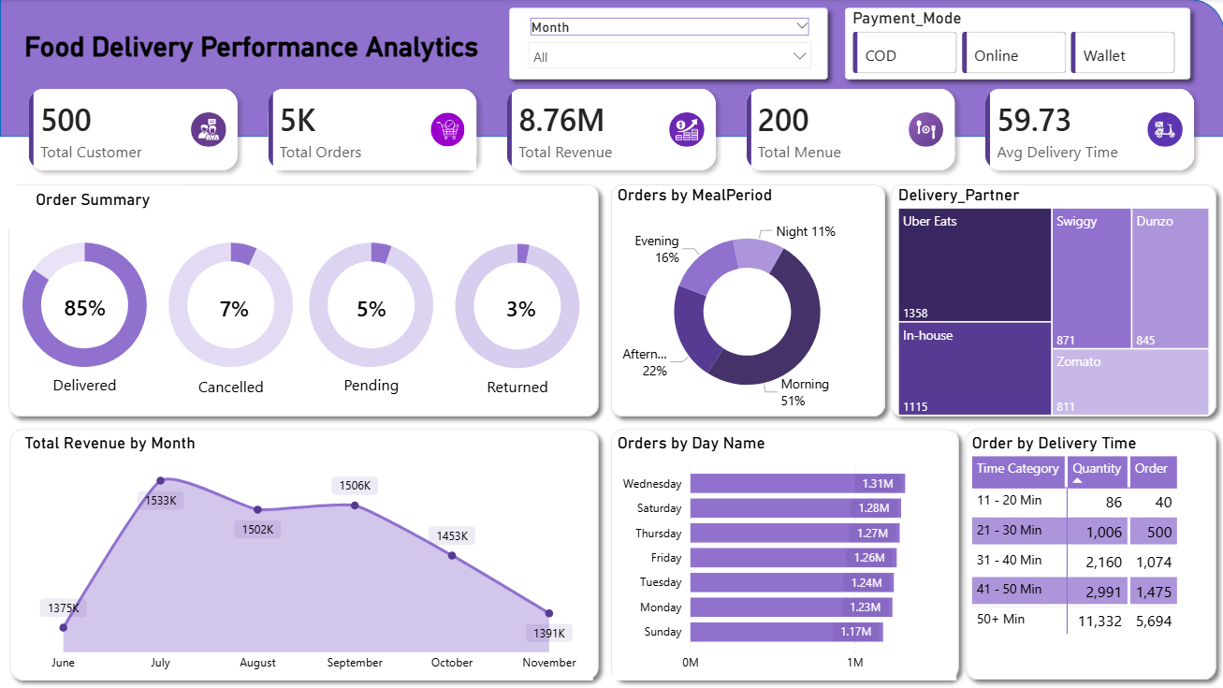
Dashboard Snapshot
contents
Contents 02
Contents 04
Enter title
Enter title
1
2
3
4
Contents 01
Contents 03
Enter title
Enter title

Slide 22
THANK YOU
Every great presentation is complete with a great
audience — and that’s you!
For feedback, improvements, or project collaboration:

